Slide 1

Beyond Decentralized
Technology Overview
https://poweredtemplate.com/02871/0/index.html

Slide 2

Mission
Fair Data Ownership Everyone owns their data Independent Software Development Developers build synergetic apps

Slide 3

Story
2015 – “Hans the Organizator”
Saw no way for people to store their own data
Started on AIRport in 2016

Slide 4
AIR
Autonomous Interdependent Repositories
* Relational
* ID Scheme
* Transaction Logs
* Autonomous
* Interdependent

Slide 5
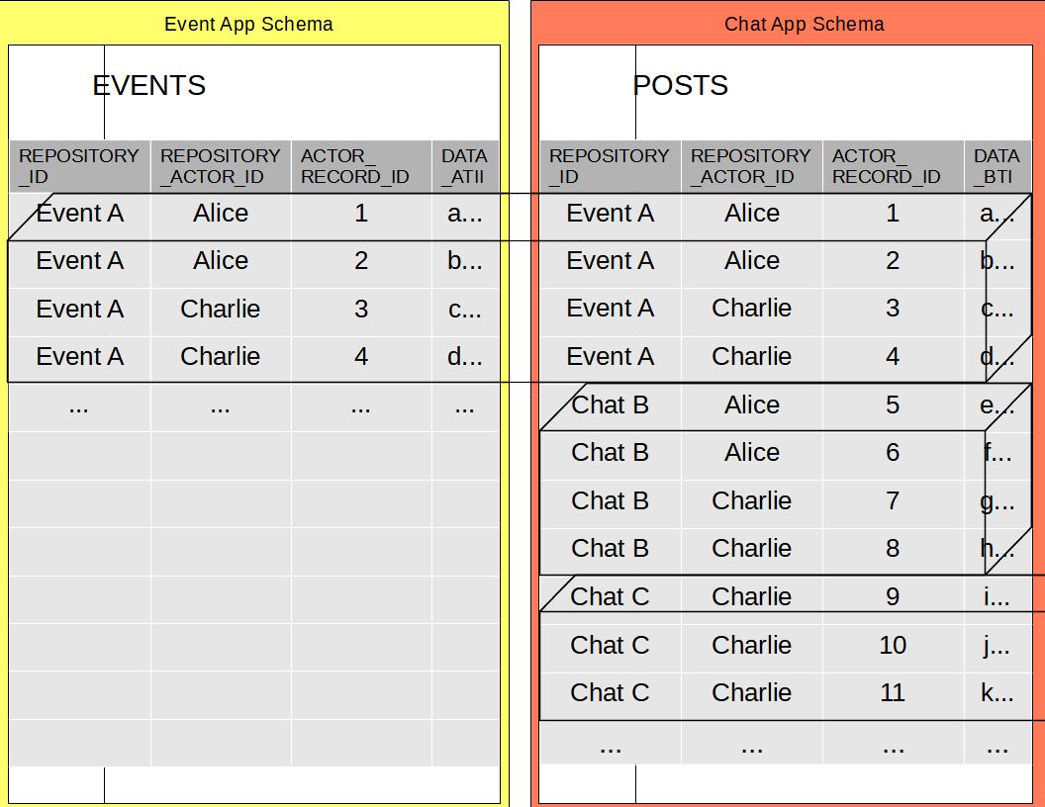
Relational
Virtual repositories in relational tables

Slide 6
ID Scheme
AIR Primary (and foreign) keys are composed of:
1 Repository_Id (GUID)
2 Repository_Actor_Id
Actor = User, on a Device, using an App
3 Actor_Record_Id (DB sequence)

Slide 7
Transaction Logs
Each Repository maintains its own Transaction Log
Each database transaction is split into per-Repository sub-transactions

Slide 8
Autonomous
Repository can be used in isolation.
All data reference via Foreign Keys is copied into the Repository

Slide 9
Interdependent
Source Repository foreign keys retained in “Original_*” key columns
Joins can be switched to use these “original” columns
Missing repositories are loaded in background

Slide 10
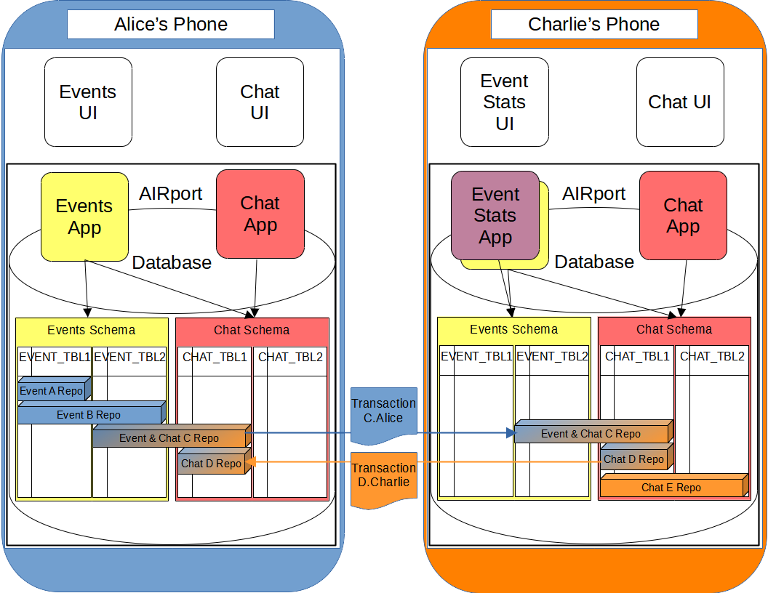
AIRport – core project

Slide 11
ORM & State
Tarmaq – Default ORM, other ORMs possible
Sessionless mapping
Original state tracked in hidden property & passed to and from UI

Slide 12
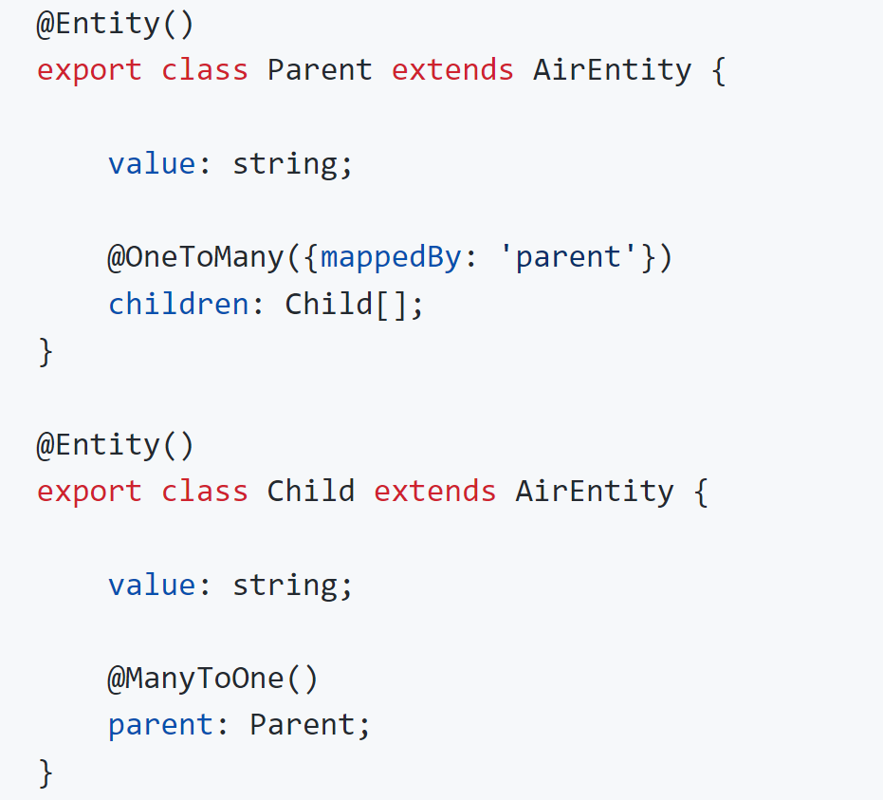
Entity Mappings
JPA style

Slide 13
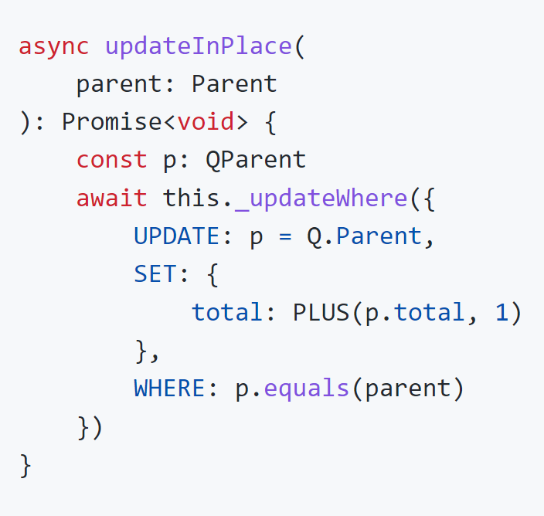
Query API
SQL-TypeScript integration

Slide 14
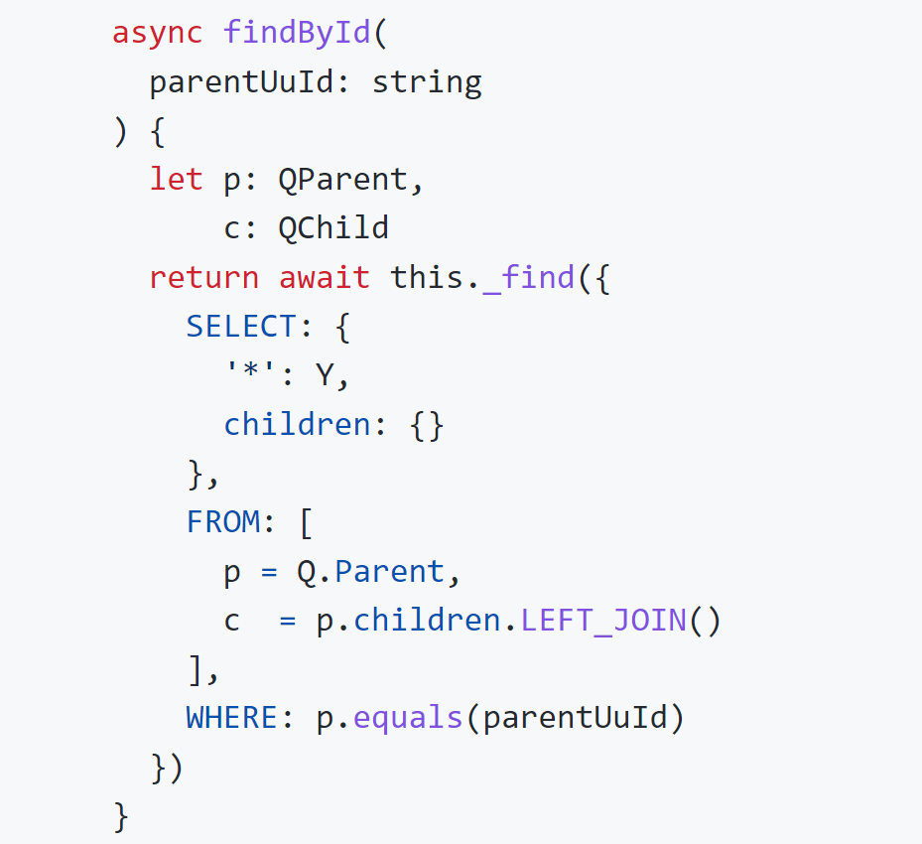
Query API
SELECT clause as an object tree:

Slide 15
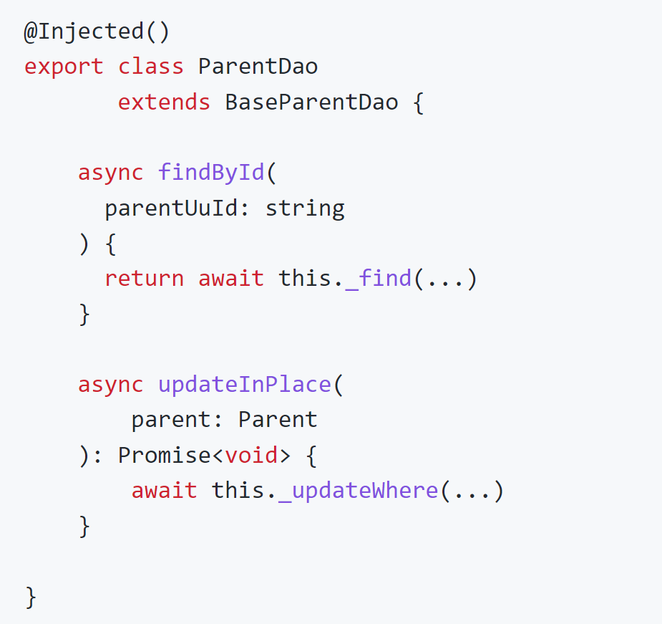
DAOs – type safety

Slide 16
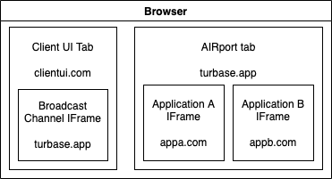
API
* Apps run in isolated VMs
* Cannot directly access the database * Can query other App Schemas * Call APIs of other Apps for persistence

Slide 17
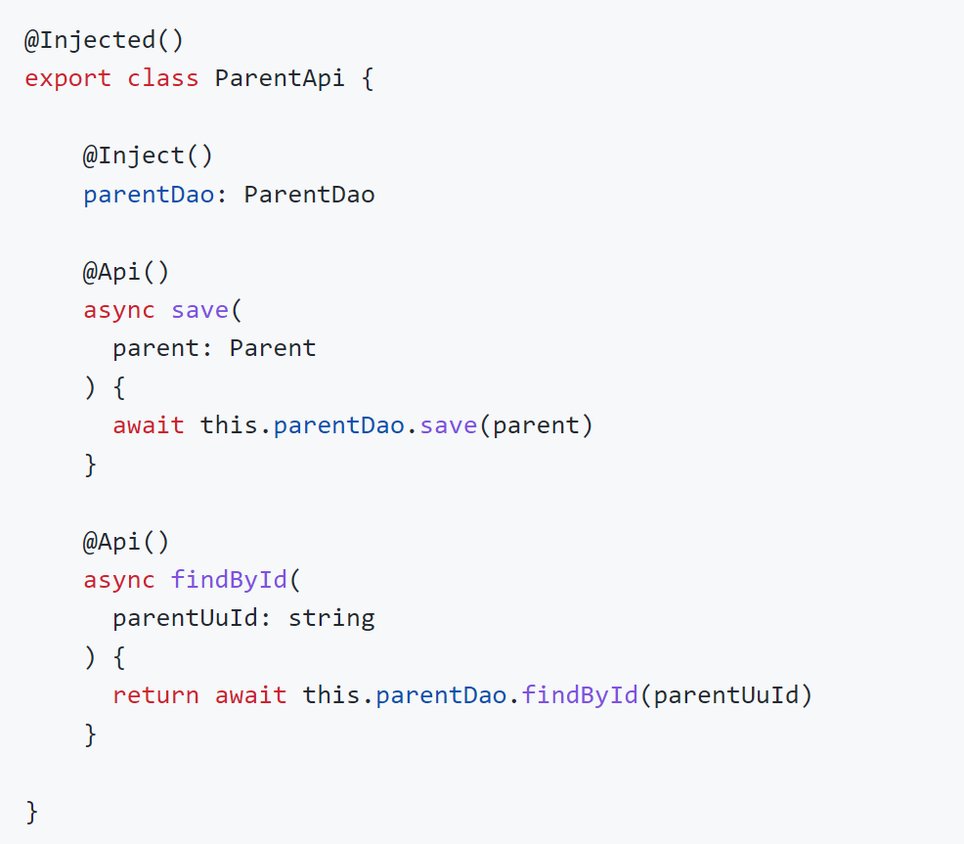
API

Slide 18
Transactions & Scope
Transactions across API calls Each API call gets its own SAVEPOINT
Access to Request Scope is provided
User, Actor info, etc. Session scope tracking is possible

Slide 19
Synchronization
Repositories are meant to exist in multiple AIRport databases (each user device has its own AIRport database) Repositories sync via Transaction Log entries Conflicts are resolved automatically based on Transaction Log entry timestamps

Slide 20
AIRbridge
Per-Repository private blockchains
SSO (Single Sign On): convenient and private options
Data Transfer optimization and storage platform Adapters (Filecoin, etc.) Unified validation for server and client

Slide 21
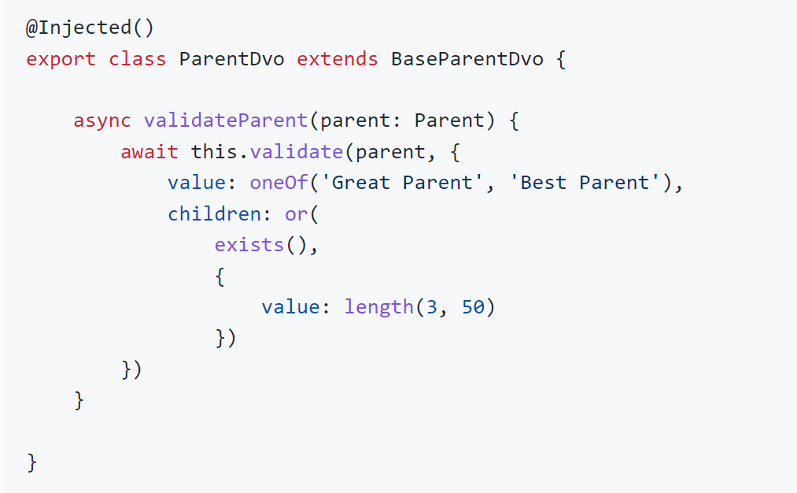
AIRbridge: Validation
Declarative and concise

Slide 22
AIRway
Peer to peer AIRport Repository peer discovery Real time updates

Slide 23
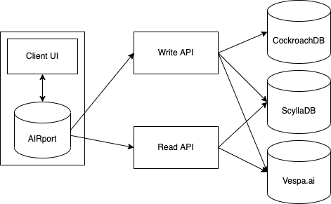
Highway
AIRport for server environment AIR for globally shared data

Slide 24
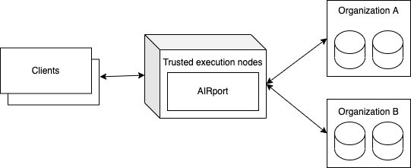
Maglev
AIRport executing on a network of execution nodes
AIRport instances pulling data from multiple data sources

